Slide 1
Foundations of Modern Networking
SDN, NFV, QoE, IoT, and Cloud
By: William Stallings

Slide 2
Chapter 4
SDN Data Plane and OpenFlow
Notes:
After studying this chapter, you should be able to
■ Present an overview of the functions of the SDN data plane.
■ Understand the concept of an OpenFlow logical network device.
■ Describe and explain the OpenFlow flow table entry structure.
■ Summarize the operation of the OpenFlow pipeline.
■ Explain the operation of the group table.
■ Understand the basic elements of the OpenFlow protocol.
Section 4.1 of this chapter begins the detailed study of software-defined networking (SDN) with a
discussion of the data plane (Figure 4.1). The remainder of the chapter is devoted to OpenFlow, the
most widely used implementation of the SDN data plane. OpenFlow is both a specification of the
logical structure of data plane functionality and a protocol between SDN controllers and network
devices. Sections 4.2 and 4.3, respectively, examine the OpenFlow logical network device and the
OpenFlow protocol in more detail.

Slide 3
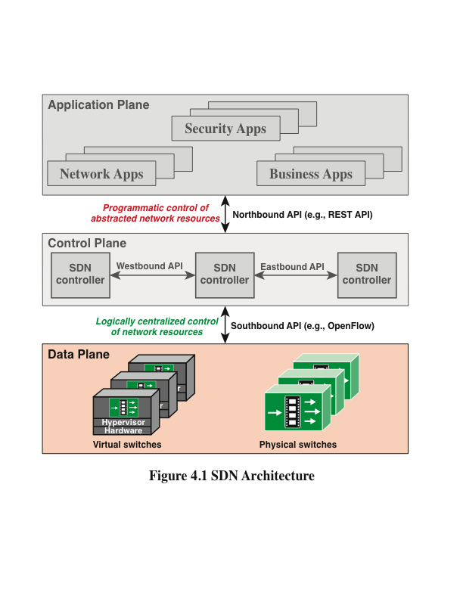
Notes:
The SDN data plane, referred to as the resource layer in ITU-T Y.3300 and also often
referred to as the infrastructure layer, is where network forwarding devices perform
the transport and processing of data according to decisions made by the SDN control
plane. The important characteristic of the network devices in an SDN network is that
these devices perform a simple forwarding function, without embedded software to
make autonomous decisions.

Slide 4
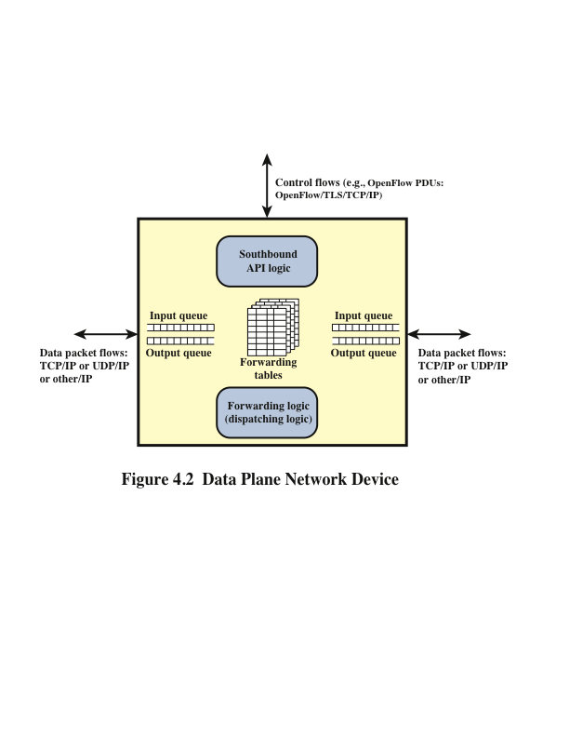
Notes:
Figure 4.2 illustrates the functions performed by the data plane network devices
(also called data plane network elements or switches). The principal functions of the
network device are the following:
■ Control support function: Interacts with the SDN control layer to support
programmability via resource-control interfaces. The switch communicates
with the controller and the controller manages the switch via the OpenFlow
switch protocol.
■ Data forwarding function: Accepts incoming data flows from other network
devices and end systems and forwards them along the data forwarding
paths that have been computed and established according to the rules defined
by the SDN applications.
These forwarding rules used by the network device are embodied in forwarding tables
that indicate for given categories of packets what the next hop in the route should be.
In addition to simple forwarding of a packet, the network device can alter the packet
header before forwarding, or discard the packet. As shown, arriving packets may be
placed in an input queue, awaiting processing by the network device, and forwarded
packets are generally placed in an output queue, awaiting transmission.
The network device in Figure 4.2 is shown with three I/O ports: one providing control
communication with an SDN controller, and two for the input and output of data
packets. This is a simple example. The network device may have multiple ports to
communicate with multiple SDN controllers, and may have more than two I/O ports
for packet flows into and out of the device.
Figure 4.2 suggests the protocols supported by the network device. Data packet flows
consist of streams of IP packets. It may be necessary for the forwarding table to define
entries based on fields in upper-level protocol headers, such as TCP, UDP, or some
other transport or application protocol. The network device examines the IP header
and possibly other headers in each packet and makes a forwarding decision.
The other important flow of traffic is via the southbound application programming
interface (API), consisting of OpenFlow protocol data units (PDUs) or some similar
southbound API protocol traffic.

Slide 5
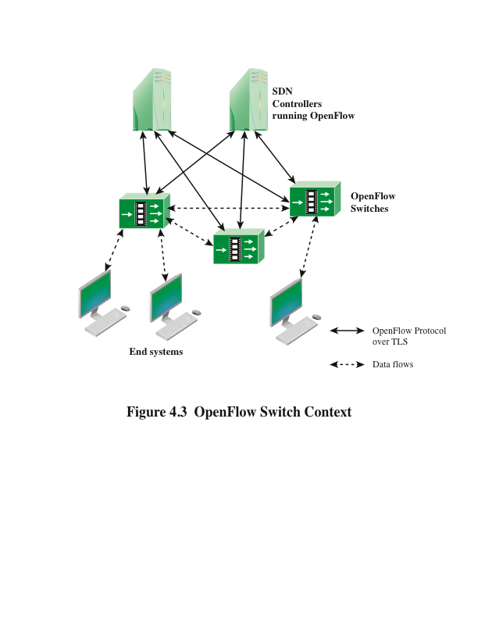
Notes:
To turn the concept of SDN into practical implementation, two requirements must be
met:
■ There must be a common logical architecture in all switches, routers, and other
network devices to be managed by an SDN controller. This logical architecture
may be implemented in different ways on different vendor equipment and in
different types of network devices, as long as the SDN controller sees a uniform
logical switch functionality.
■ A standard, secure protocol is needed between the SDN controller and the
network device.
These requirements are addressed by OpenFlow, which is both a protocol between
SDN controllers and network devices and a specification of the logical structure of the
network switch functionality. OpenFlow is defined in the OpenFlow Switch Specification ,
published by the Open Networking Foundation (ONF).
This section covers the logical switch architecture defined by OpenFlow. Our
discussion is based on the OpenFlow specification current at the time of this writing:
Version 1.5.1, March 26, 2015.
Figure 4.3 indicates the main elements of an OpenFlow environment, consisting
of SDN controllers that include OpenFlow software, OpenFlow switches, and end
systems.

Slide 6
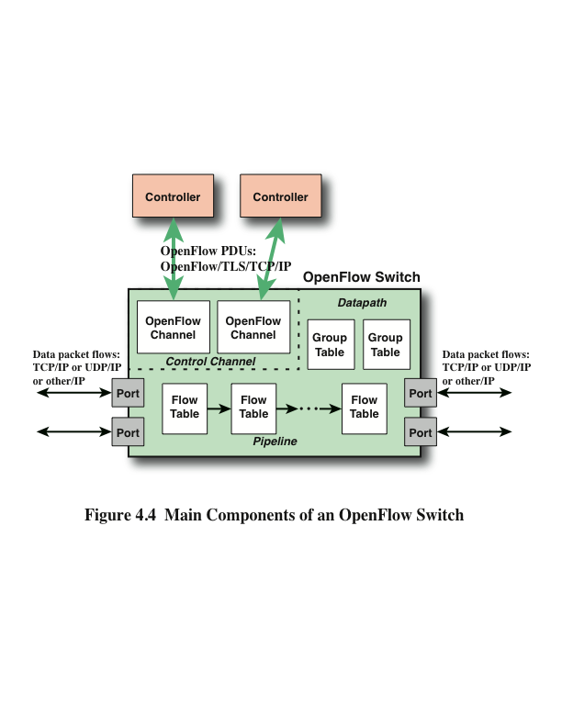
Notes:
Figure 4.4 displays the main components of an OpenFlow switch. An SDN
controller communicates with OpenFlow-compatible switches using the OpenFlow
protocol running over Transport Layer Security (TLS). Each switch connects to
other OpenFlow switches and, possibly, to end-user devices that are the sources
and destinations of packet flows. On the switch side, the interface is known as an
OpenFlow channel . These connections are via OpenFlow ports. An OpenFlow
port also connects the switch to the SDN controller. OpenFlow defines three types
of ports:
■ Physical port: Corresponds to a hardware interface of the switch. For example,
on an Ethernet switch, physical ports map one to one to the Ethernet
interfaces.
■ Logical port: Does not correspond directly to a hardware interface of the
switch. Logical ports are higher-level abstractions that may be defined in the
switch using non-OpenFlow methods (for example, link aggregation groups,
tunnels, loopback interfaces). Logical ports may include packet encapsulation
and may map to various physical ports. The processing done by the logical port
is implementation dependent and must be transparent to OpenFlow processing,
and those ports must interact with OpenFlow processing like OpenFlow
physical ports.
■ Reserved port: Defined by the OpenFlow specification. It specifies generic
forwarding actions such as sending to and receiving from the controller, flooding,
or forwarding using non-OpenFlow methods, such as “normal” switch
processing.
The OpenFlow specification defines three types of tables in the logical switch architecture.
A flow table matches incoming packets to a particular flow and specifies
what functions are to be performed on the packets. There may be multiple flow tables
that operate in a pipeline fashion, as explained subsequently. A flow table may direct
a flow to a group table , which may trigger a variety of actions that affect one or
more flows. A meter table can trigger a variety of performance-related actions on a
flow. Meter tables are discussed in Chapter 10. Using the OpenFlow switch protocol,
the controller can add, update, and delete flow entries in tables, both reactively (in
response to packets) and proactively.

Slide 7
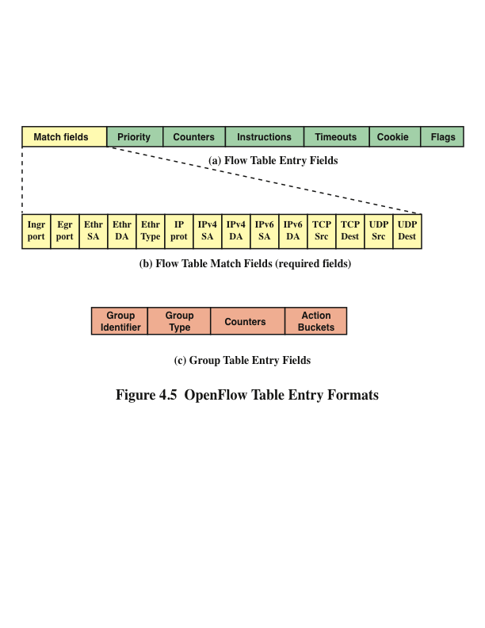
Notes:
The basic building block of the logical switch architecture is the flow table . Each
packet that enters a switch passes through one of more flow tables. Each flow table
consists of a number of rows, called entries , consisting of seven components (see part
a of Figure 4.5), as defined in the list that follows.
■ Match fields: Used to select packets that match the values in the fields.
■ Priority: Relative priority of table entries. This is a 16-bit field with 0 corresponding
to the lowest priority. In principle, there could be 216 = 64k priority
levels.
■ Counters: Updated for matching packets. The OpenFlow specification
defines a variety of counters.
■ Instructions: Instructions to be performed if a match occurs.
■ Timeouts: Maximum amount of idle time before a flow is expired by the
switch. Each flow entry has an idle_timeout and a hard_timeout associated
with it. A nonzero hard_timeout field causes the flow entry to be removed after
the given number of seconds, regardless of how many packets it has matched.
A nonzero idle_timeout field causes the flow entry to be removed when it has
matched no packets in the given number of seconds.
■ Cookie: 64-bit opaque data value chosen by the controller. May be used by
the controller to filter flow statistics, flow modification and flow deletion; not
used when processing packets.
■ Flags: Flags alter the way flow entries are managed; for example, the flag
OFPFF_SEND_FLOW_REM triggers flow removed messages for that flow entry.
The match fields component of a table entry consists of the following required fields
(see part b of Figure 4.5):
■ Ingress port: The identifier of the port on this switch on which the packet arrived.
This may be a physical port or a switch-defined virtual port. Required in
ingress tables.
■ Egress port: The identifier of the egress port from action set. Required in
egress tables.
■ Ethernet source and destination addresses: Each entry can be an
exact address, a bitmasked value for which only some of the address bits are
checked, or a wildcard value (match any value).
■ Ethernet type field: Indicates type of the Ethernet packet payload.
■ IP: Version 4 or 6.
■ IPv4 or IPv6 source address, and destination address: Each entry
can be an exact address, a bitmasked value, a subnet mask value, or a wildcard
value.
■ TCP source and destination ports: Exact match or wildcard value.
■ UDP source and destination ports: Exact match or wildcard value.

Slide 8
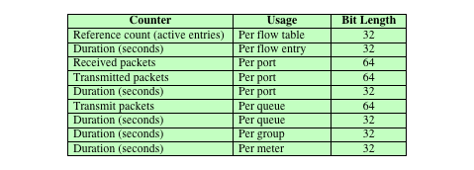
Table 4.1 Required OpenFlow Counters
Notes:
Table 4.1 lists the counters that must be
supported by an OpenFlow switch.

Slide 9
Flow Table Pipeline
A switch includes one or more flow tables
If there is more than one flow table, they are organized as a pipeline, with the tables labeled with increasing numbers starting with zero
The use of multiple tables in a pipeline, rather than a single flow table, provides the SDN controller with considerable flexibility
The OpenFlow specification defines two stages of processing:
Ingress processing
Egress processing
Notes:
A switch includes one or more flow tables. If there is more than one flow table, they
are organized as a pipeline, with the tables labeled with increasing numbers starting
with zero. The use of multiple tables in a pipeline, rather than a single flow table,
provides the SDN controller with considerable flexibility.
The OpenFlow specification defines two stages of processing:
■ Ingress processing: Ingress processing always happens, beginning with
Table 0, and uses the identity of the input port. Table 0 may be the only table, in
which case the ingress processing is simplified to the processing performed on
that single table, and there is no egress processing.
■ Egress processing: Egress processing is the processing that happens after
the determination of the output port. It happens in the context of the output
port. This stage is optional. If it occurs, it may involve one or more tables. The
separation of the two stages is indicated by the numerical identifier of the first
egress table. All tables with a number lower than the first egress table must be
used as ingress tables, and no table with a number higher than or equal to the
first egress table can be used as an ingress table.

Slide 10
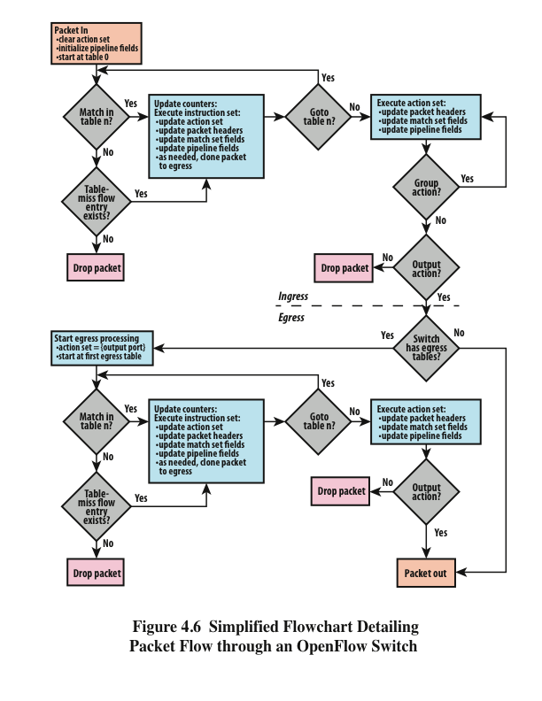
Notes:
Pipeline processing always starts with ingress processing at the first flow table; the
packet must be first matched against flow entries of flow Table 0. Other ingress
flow tables may be used depending on the outcome of the match in the first table.
If the outcome of ingress processing is to forward the packet to an output port, the
OpenFlow switch may perform egress processing in the context of that output port.
When a packet is presented to a table for matching, the input consists of the packet, the
identity of the ingress port, the associated metadata value, and the associated action
set. For Table 0, the metadata value is blank and the action set is null. At each table,
processing proceeds as follows (see Figure 4.6):
1. If there is a match on one or more entries, other than the table-miss entry, the
match is defined to be with the highest-priority matching entry. As mentioned
in the preceding discussion, the priority is a component of a table entry and is
set via OpenFlow; the priority is determined by the user or application invoking
OpenFlow. The following steps may then be performed:
a. Update any counters associated with this entry.
b. Execute any instructions associated with this entry. This may include
updating the action set, updating the metadata value, and performing actions.
c. The packet is then forwarded to a flow table further down the pipeline, to
the group table, to the meter table, or directed to an output port.
2. If there is a match only on a table-miss entry, the table entry may contain
instructions, as with any other entry. In practice, the table-miss entry specifies
one of three actions:
a. Send packet to controller. This will enable the controller to define a new
flow for this and similar packets, or decide to drop the packet.
b. Direct packet to another flow table farther down the pipeline.
c. Drop the packet.
3. If there is no match on any entry and there is no table-miss entry, the packet is
dropped.

Slide 11
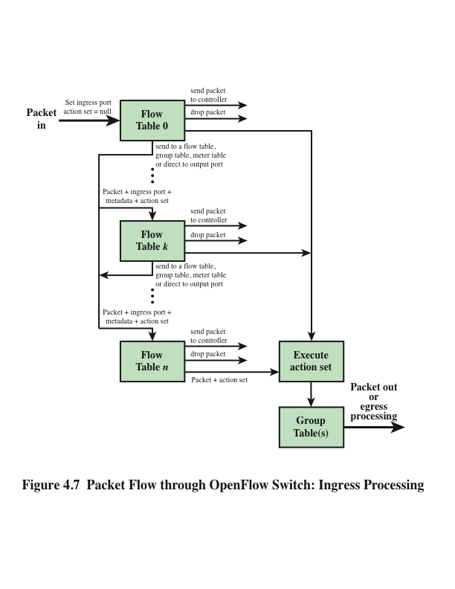
Notes:
For the final table in the pipeline, forwarding to another flow table is not an option.
If and when a packet is finally directed to an output port, the accumulated action set
is executed and then the packet is queued for output. Figure 4.7 illustrates the overall
ingress pipeline process.

Slide 12
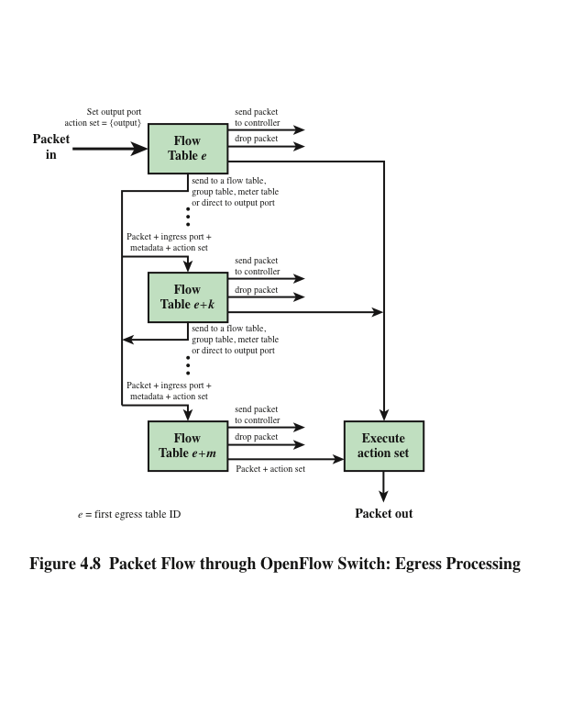
Notes:
If egress processing is associated with a particular output port, then after a packet
is directed to an output port at the completion of the ingress processing, the packet
is directed to the first flow table of the egress pipeline. Egress pipeline processing
proceeds in the same fashion as for ingress processing, except that there is no group
table processing at the end of the egress pipeline. Egress processing is shown in
Figure 4.8.

Slide 13
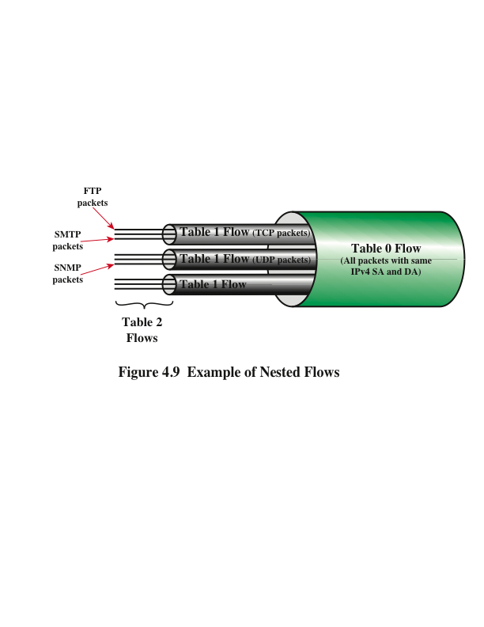
Notes:
The use of multiple tables enables the nesting of flows, or put another way, the breaking
down of a single flow into a number of parallel subflows. Figure 4.9 illustrates this
property. In this example, an entry in Table 0 defines a flow consisting of packets
traversing the network from a specific source IP address to a specific destination IP
address. Once a least-cost route between these two endpoints is established, it might
make sense for all traffic between these two endpoints to follow that route, and the
next hop on that route from this switch can be entered in Table 0. In Table 1, separate
entries for this flow can be defined for different transport layer protocols, such as
TCP and UDP. For these subflows, the same output port might be retained so that
the subflows all follow the same route. However, TCP includes elaborate congestion
control mechanisms not normally found with UDP, so it might be reasonable to handle
the TCP and UDP subflows differently in terms of quality of service (QoS)-related
parameters. Any of the Table 1 entries could immediately route its respective subflow
to the output port, but some or all of the entries may invoke Table 2, further dividing
each subflow. The figure shows that the TCP subflow could be divided on the basis of
the protocol running on top of TCP, such as Simple Mail Transfer Protocol (SMTP) or
File Transfer Protocol (FTP). Similarly, the UDP flow could be subdivided based on
protocols running on UDP, such as Simple Network Management Protocol (SNMP).
The figure also indicates other subflows at Table 1 and 2, which may be used for other
Purposes.
For this example, it would be possible to define each of these fine-grained subflows
in Table 0. The use of multiple tables simplifies the processing in both the SDN
controller and the OpenFlow switch. Actions such as next hop that apply to the
aggregate flow can be defined once by the controller and examined and performed
once by the switch. The addition of new subflows at any level involves less setup.
Therefore, the use of pipelined, multiple tables increases the efficiency of network
operations, provides granular control, and enables the network to respond to real-time
changes at the application, user, and session levels.

Slide 14
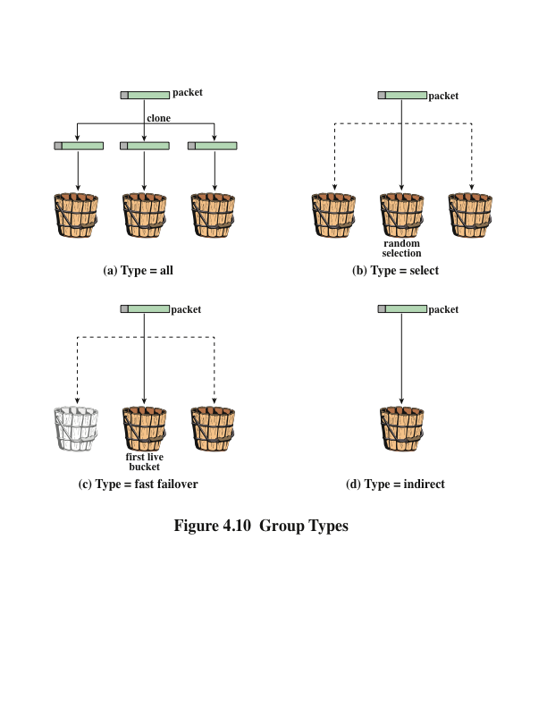
Notes:
In the course of pipeline processing, a flow table may direct a flow of packets to
the group table rather than another flow table. The group table and group actions
enable OpenFlow to represent a set of ports as a single entity for forwarding packets.
Different types of groups are provided to represent different forwarding abstractions,
such as multicasting and broadcasting.
Each group table consists of a number of rows, called group entries, consisting of four
components (refer back to part c of Figure 4.5):
■ Group identifier: A 32-bit unsigned integer uniquely identifying the group.
A group is defined as an entry in the group table.
■ Group type: To determine group semantics, as explained subsequently.
■ Counters: Updated when packets are processed by a group.
■ Action buckets: An ordered list of action buckets, where each action bucket
contains a set of actions to execute and associated parameters.
Each group includes a set of one or more action buckets. Each bucket contains a list
of actions. Unlike the action set associated with a flow table entry, which is a list of
actions that accumulate while the packet is processed by each flow table, the action
list in a bucket is executed when a packet reaches a bucket. The action list is executed
in sequence and generally ends with the Output action, which forwards the packet
to a specified port. The action list may also end with the Group action, which sends
the packet to another group. This enables the chaining of groups for more complex
processing.
A group is designated as one of the types depicted in Figure 4.10: all, select, fast
Failover, and indirect.
The all type executes all the buckets in the group. Thus, each arriving packet is effectively
cloned. Typically, each bucket will designate a different output port, so that the
incoming packet is then transmitted on multiple output ports. This group is used for
multicast or broadcast forwarding.
The select type executes one bucket in the group, based on a switch-computed
selection algorithm (for example, hash on some user-configured tuple or simple roundrobin).
The selection algorithm should implement equal load sharing or, optionally,
load sharing based on bucket weights assigned by the SDN controller.
The fast failover type executes the first live bucket. Port liveness is managed by code
outside of the scope of OpenFlow and may have to do with routing algorithms or
congestion control mechanisms. The buckets are evaluated in order, and the first live
bucket is selected. This group type enables the switch to change forwarding without
requiring a round trip to the controller.
The three just-mentioned types all work with a single packet flow. The indirect type
allows multiple packet flows (that is, multiple flow table entries) to point to a common
group identifier. This type provides for more efficient management by the controller
in certain situations. For example, suppose that there are 100 flow entries that have
the same match value in the IPv4 destination address match field, but differ in some
other match field, but all of them forward the packet to port X by including the action
Output X on the action list. We can instead replace this action with the action Group
GID, where GID is the ID of an indirect group entry that forwards the packet to port
X. If the SDN controller needs to change from port X to port Y, it is not necessary to
update all 100 flow table entries. All that is required is to update the group entry.

Slide 15
OpenFlow Protocol
The OpenFlow protocol describes message exchanges that take place between an OpenFlow controller and an OpenFlow switch
Typically, the protocol is implemented on top of TLS, providing a secure OpenFlow channel
The OpenFlow protocol enables the controller to perform add, update, and delete actions to the flow entries in the flow tables
It supports three types of messages:
Controller to switch
Asynchronous
Symmetric
Notes:
The OpenFlow protocol describes message exchanges that take place between an
OpenFlow controller and an OpenFlow switch. Typically, the protocol is implemented
on top of TLS, providing a secure OpenFlow channel.
The OpenFlow protocol enables the controller to perform add, update, and delete
actions to the flow entries in the flow tables. It supports three types of messages (see
Table 4.2):
■ Controller to switch: These messages are initiated by the controller and, in
some cases, require a response from the switch. This class of messages enables
the controller to manage the logical state of the switch, including its configuration
and details of flow and group table entries. Also included in this class
is the Packet-out message. This message is sent by the controller to a switch
when that switch sends a packet to the controller and the controller decides not
to drop the packet but to direct it to a switch output port.
■ Asynchronous: These types of messages are sent without solicitation from
the controller. This class includes various status messages to the controller.
Also included is the Packet-in message, which may be used by the switch to
send a packet to the controller when there is no flow table match.
■ Symmetric: These messages are sent without solicitation from either the
controller or the switch. They are simple yet helpful. Hello messages are
typically sent back and forth between the controller and switch when the
connection is first established. Echo request and reply messages can be used
by either the switch or controller to measure the latency or bandwidth of a
controller-switch connection or just verify that the device is up and running.
The Experimenter message is used to stage features to be built in to future
versions of OpenFlow.

Slide 16
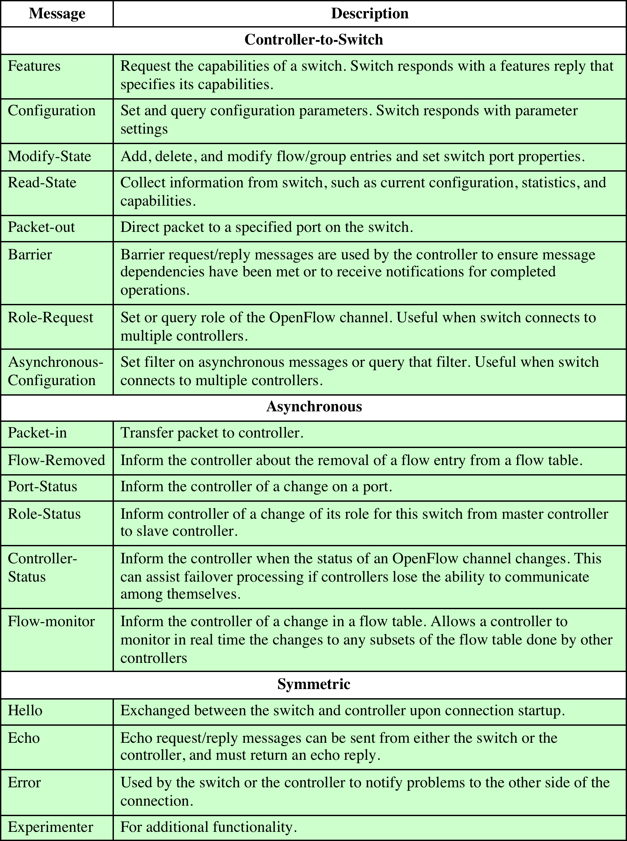
Table 4.2
OpenFlow Messages
Notes:
Table 4.2 OpenFlow Messages

Slide 17
End of Chapter 4

